Slide 1
This slide show has a built-in verbal commentary and is set up to play automatically.
To start the slide show – go to ‘Slide Show’ on the pulldown menu on the top and click on ‘From Beginning’ on the far left.

Slide 2


Sustainability in Architecture & Planning
ABOUT ME
Bela Syal, BArch, MEDes, MBA
1992-2017 Senior Partner, Brown & Associates Planning Group, Calgary, Canada
2017 – Present Planning Lead and Strategic Advisor, Situated Consulting, Calgary, Canada

Slide 3
SUSTAINABILITY in Architecture & Planning
TRIPLE BOTTOM LINE
4 PART SERIES
Part 1: SUSTAINABILITY OVERVIEW

Slide 4
Triple Bottom Line Sustainability Series
PART 1: SUSTAINABILITY OVERVIEW
PART 2: ENVIRONMENTAL SUSTAINABILITY
PART 3: SOCIAL & ECONOMIC SUSTAINABILITY
PART 4: PROJECT EXAMPLES

Slide 5
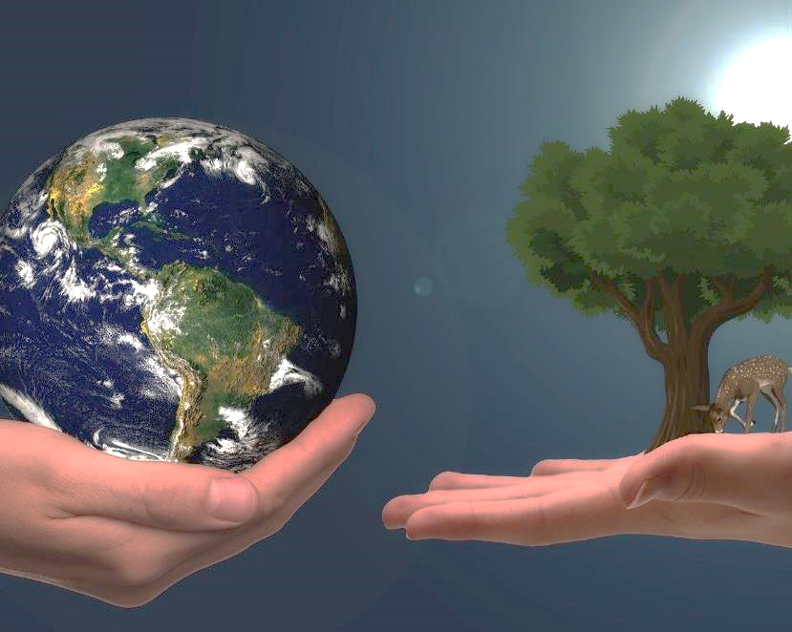
What is Sustainability
DEFINITION
Sustainability consists of fulfilling the needs of current generations without compromising the needs of future generations, while ensuring a balance between environmental care, social well-being and economic growth.

Slide 6
Three Pillars of Sustainability
ENVIRONMENTAL
SOCIAL & CULTURAL
ECONOMIC
TRIPLE BOTTOM LINE

Slide 7
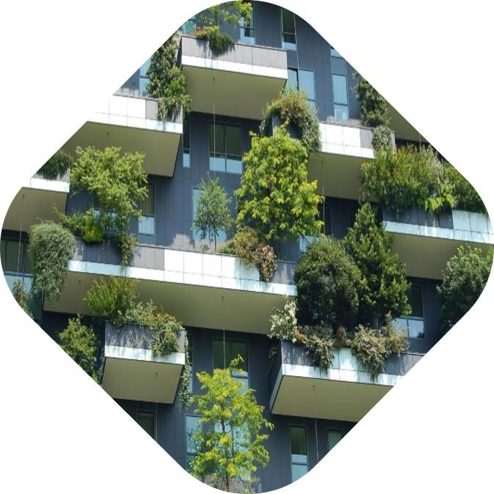
What is Environmental Sustainability
DEFINITION
The definition of Environmental sustainability is the ability to maintain an ecological balance in our planet's natural environment and conserve natural resources to support the wellbeing of current and future generations.

Slide 8
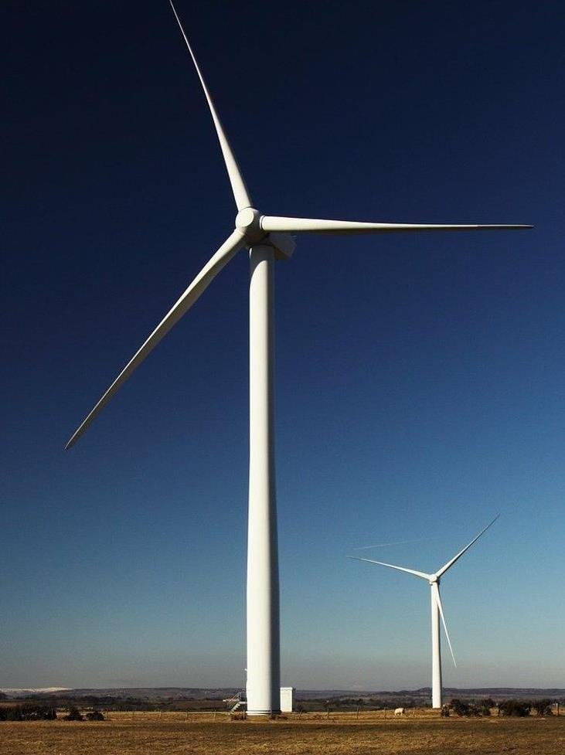
Environmental Sustainability
Environmental Sustainability at a Macro Scale
Reducing our Carbon Footprint
Reduction of our carbon footprint and decrease on consumption of non-renewal fossil fuels which are major polluters and contributors to GHGs or greenhouse gases.
Eco Restoration
Preservation of our natural features, increasing our tree canopies, waste management and sanitary infrastructure all in an attempt to lessen pollution and provide clean air
Climate Resilience
Scientists are drawing a direct correlation between the increase in natural disasters and climate change
What is our role as Architects and Planners to address these issues?

Slide 9
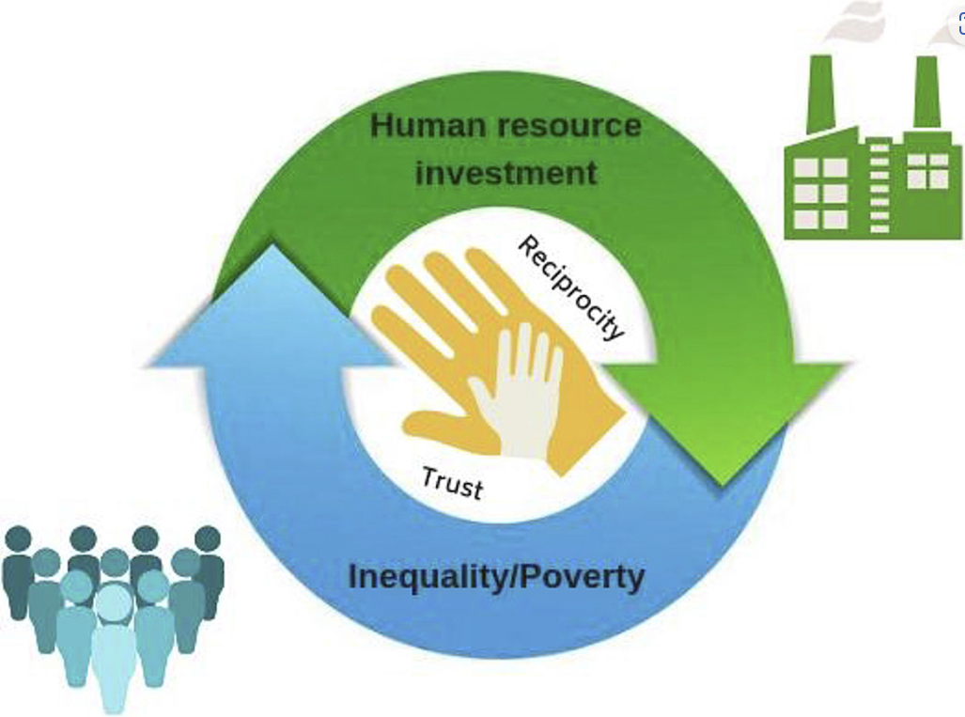
What is Social Sustainability
DEFINITION
Social Sustainability is generally understood as 'the ability of a social system to function at a defined level of social well-being indefinitely'.

Slide 10

What is Economic Sustainability
DEFINITION
At a macro level, Economic sustainability refers to practices that support long-term economic growth without negatively impacting social, environmental, and cultural aspects of the community.

Slide 11

Thank You
TRIPLE BOTTOM LINE SERIES
END OF PART 1: SUSTAINABILITY OVERVIEW
Part 2
Environmental Sustainability
Part 3
Social & Economic Sustainability
Part 4
Project Examples

