Slide 1
This slide show has a built-in verbal commentary and is set up to play automatically.
To start the slide show – go to ‘Slide Show’ on the pulldown menu on the top and click on ‘From Beginning’ on the far left.

Slide 2

SUSTAINABILITY in Architecture & Planning
TRIPLE BOTTOM LINE
4 PART SERIES
Part 2:
ENVIRONMENTAL SUSTAINABILITY

Slide 3
Triple Bottom Line Sustainability Series
PART 1: SUSTAINABILITY OVERVIEW
PART 2: ENVIRONMENTAL SUSTAINABILITY
PART 3: SOCIAL & ECONOMIC SUSTAINABILITY
PART 4: PROJECT EXAMPLES

Slide 4
Environmental Sustainability - Architecture
Sustainable Design Principles for Building Structures
Use of Local and Indigenous Materials
rather than importing materials that use carbon intensive methods for manufacturing and transporting to the site.
Integration of Passive Design Elements
Include building orientation, minimizing the creation of heat islands, designing breezeways and cross-ventilation effects
Decreasing our Reliance on Non-Renewables
As India modernizes, the discussion of using non-renewable energy sources is becoming more relevant

Slide 5
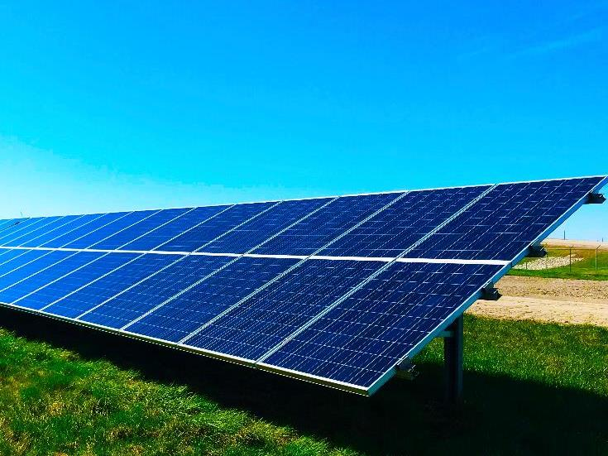
Renewable Energy Sources
WORKING TOWARDS NET ZERO
Solar Power is the top and most effective way of harnessing renewable energy sources, at this time
Wind Energy harnessing wind energy through windmills and wind turbines is on the rise
Geothermal Energy which is extracting heat from the Earth’s core, is in its infancy but is catching traction

Slide 6
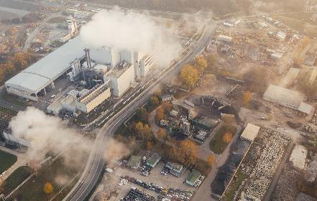
Environmental Sustainability – Urban Planning
ENVIRONMENTAL JUSTICE
UN Adopted Sustainable Development Goals (SDG)
SDG 11: Sustainable Cities and Communities
Environmental Justice – Right to healthy and clean air for all

Slide 7
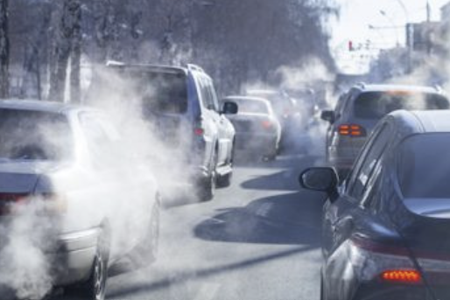
Transportation
Sustainability Design Principles in Transportation Planning
Better Public Transit
Invest in public transit systems such as metros, to discourage the use of cars, which is a major polluter.
Transit-Oriented Development (TOD)
Locate highest intensity of development close to transit stations so more people take transit.
Complete Mixed-Use Communities and Neighbourhoods
Locate residential, employment, shopping, health and education services in close proximity so people can reduce commute times for their daily needs.
Alternate Modes of Transportation
Develop bikeways and pathways as alternate transportation modes to reduce car dependence.

Slide 8
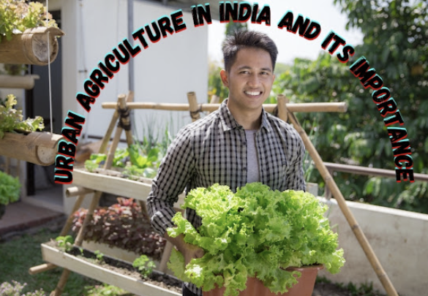
Preservation & Eco Restoration
Sustainability Design Principles in
Preservation & Eco Restoration Planning
Preservation of Natural Resources
Preserve and integrate our natural features or restore them if they are damaged as a result of development.
Urban Forestry / Tree Canopy
Increase tree canopy through tree planning programs to create more shaded areas.
Urban Agriculture / Urban Farming
Trusted partner
Innovation excellence

Slide 9
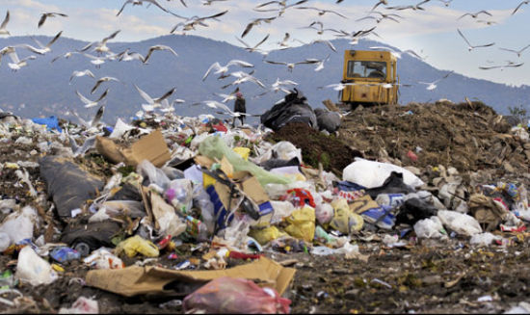
Sustainable Infrastructure
ENVIRONMENTAL SUSTAINABILITY
Sanitary Utility Infrastructure – Clean potable water and covered sanitary sewer lines remains an infrastructure gaps in many parts of India.
Effective Waste Management – Fighting mountains of garbage is a big issue in most urban areas in India.

Slide 10

Thank You
TRIPLE BOTTOM LINE SERIES
END OF PART 2: ENVIRONMENTAL SUSTAINABILITY
Part 1
Sustainability Overview
Part 3
Social & Economic Sustainability
Part 4
Project Examples

