Slide 1
This slide show has a built-in verbal commentary and is set up to play automatically.
To start the slide show – go to ‘Slide Show’ on the pulldown menu on the top and click on ‘From Beginning’ on the far left.

Slide 2

SUSTAINABILITY in Architecture & Planning
TRIPLE BOTTOM LINE
4 PART SERIES
Part 3: SOCIAL &
ECONOMIC SUSTAINABILITY

Slide 3
Triple Bottom Line Sustainability Series
PART 1: SUSTAINABILITY OVERVIEW
PART 2: ENVIRONMENTAL SUSTAINABILITY
PART 3: SOCIAL & ECONOMIC SUSTAINABILITY
PART 4: PROJECT EXAMPLES

Slide 4
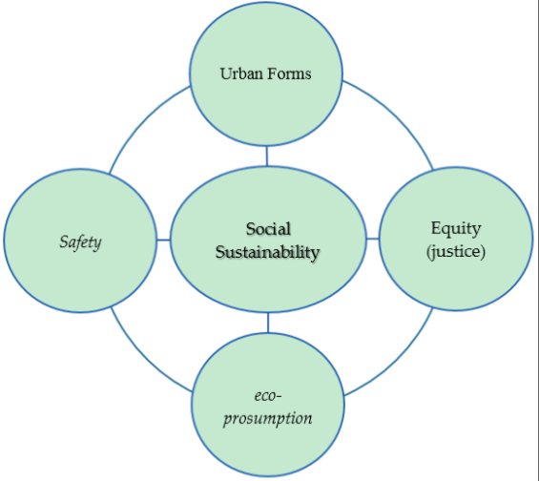

Social & Cultural Sustainability
COMPLEXITY

Slide 5
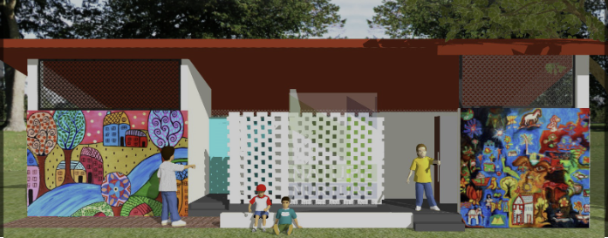
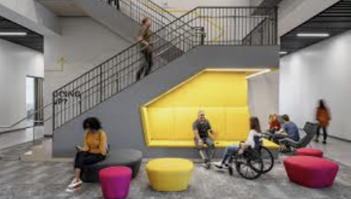
Social Sustainability - Architecture
SOCIAL JUSTICE & EQUALITY
Sustainability Design Principles in Social Sustainability
Accessible Places & Inclusive Design
Create more accessible places and spaces for people with disabilities.
Visual Design and Public Spaces that foster Social Interaction
This is more subjective and is difficult to quantify.

Slide 6
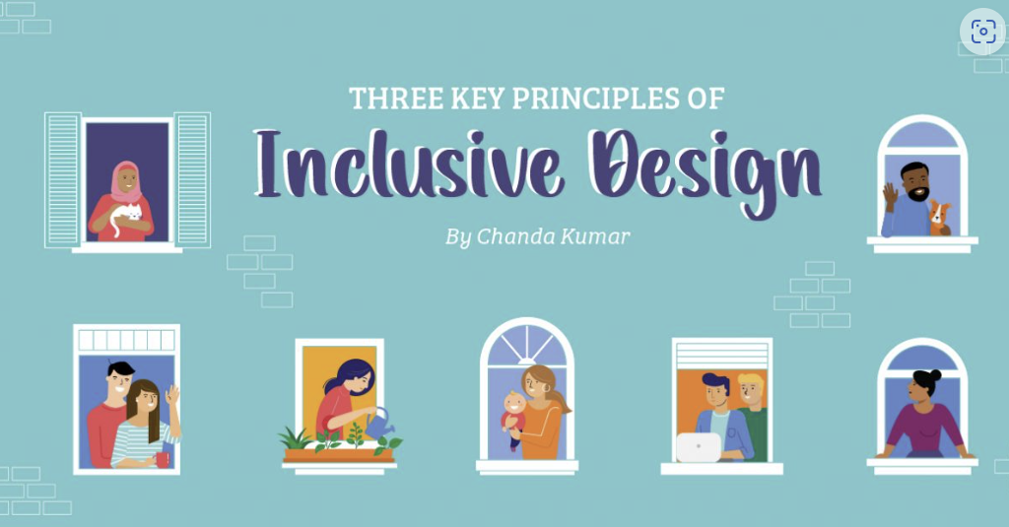
Social Sustainability – Urban Planning
SOCIAL JUSTICE & EQUALITY
Sustainability Design Principles in Social Sustainability
Foster Diversity, Inclusivity & Equity
Preserve and integrate our natural features or restore them if they are damaged as a result of development.
Locate Amenities close to more Densely Populated Areas
Break down social barriers and narrow the gap between the haves and have nots.

Slide 7
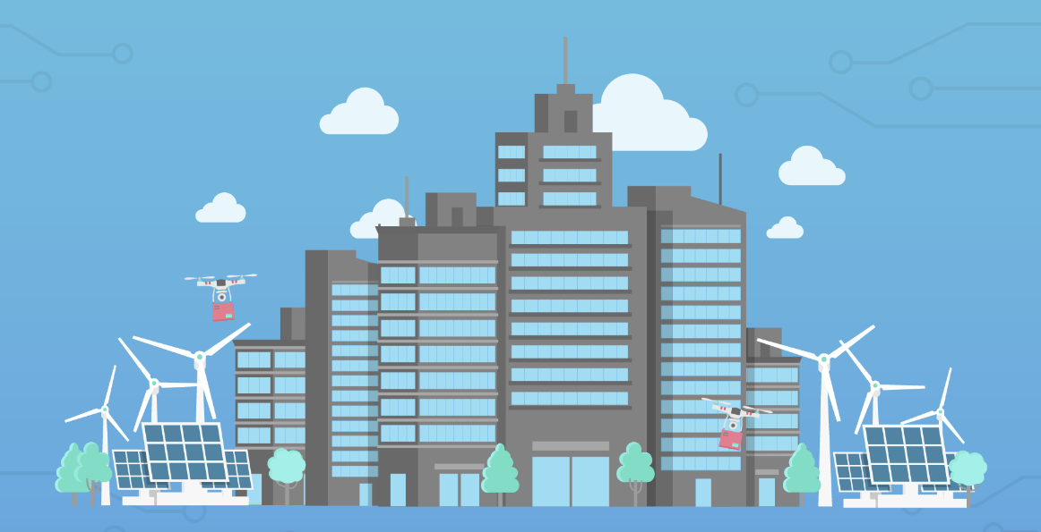
Economic Sustainability
ECONOMIC SUSTAINABILITY
Achieve a balance between:
CAPITAL COSTS: costs incurred to build a structure.
OPERATING COSTS: costs incurred to run a structure on an ongoing basis
MAINTENANCE & LIFECYCLE COSTS: costs incurred to maintain a structure over its lifetime.

Slide 8

Thank You
TRIPLE BOTTOM LINE SERIES
END OF PART 3:
SOCIAL & ECONOMIC SUSTAINABILITY
Part 1
Sustainability Overview
Part 2
Environmental Sustainability
Part 4
Project Examples

