Slide 1
This slide show has a built-in verbal commentary and is set up to play automatically.
To start the slide show – go to ‘Slide Show’ on the pulldown menu on the top and click on ‘From Beginning’ on the far left.

Slide 2

SUSTAINABILITY in Architecture & Planning
TRIPLE BOTTOM LINE
4 PART SERIES
Part 4: PROJECT EXAMPLES

Slide 3
Triple Bottom Line Sustainability Series
PART 1: SUSTAINABILITY OVERVIEW
PART 2: ENVIRONMENTAL SUSTAINABILITY
PART 3: SOCIAL & ECONOMIC SUSTAINABILITY
PART 4: PROJECT EXAMPLES

Slide 4
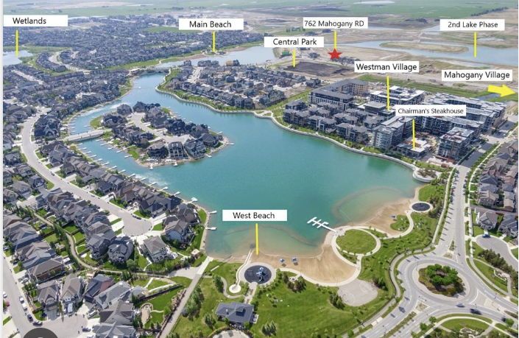
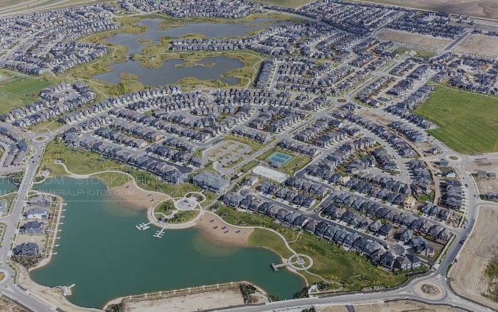
Project Examples
Integrating Sustainability in Design
Mahogany
a large master planned community, 1,300 acres in size and 75% complete
Rangeview
a 320-acre Urban Agriculture Community, which was recently launched in 2020
Midfield Heights
a smaller 24.3-acre Transit-Oriented redevelopment site, approved in 2021

Slide 5
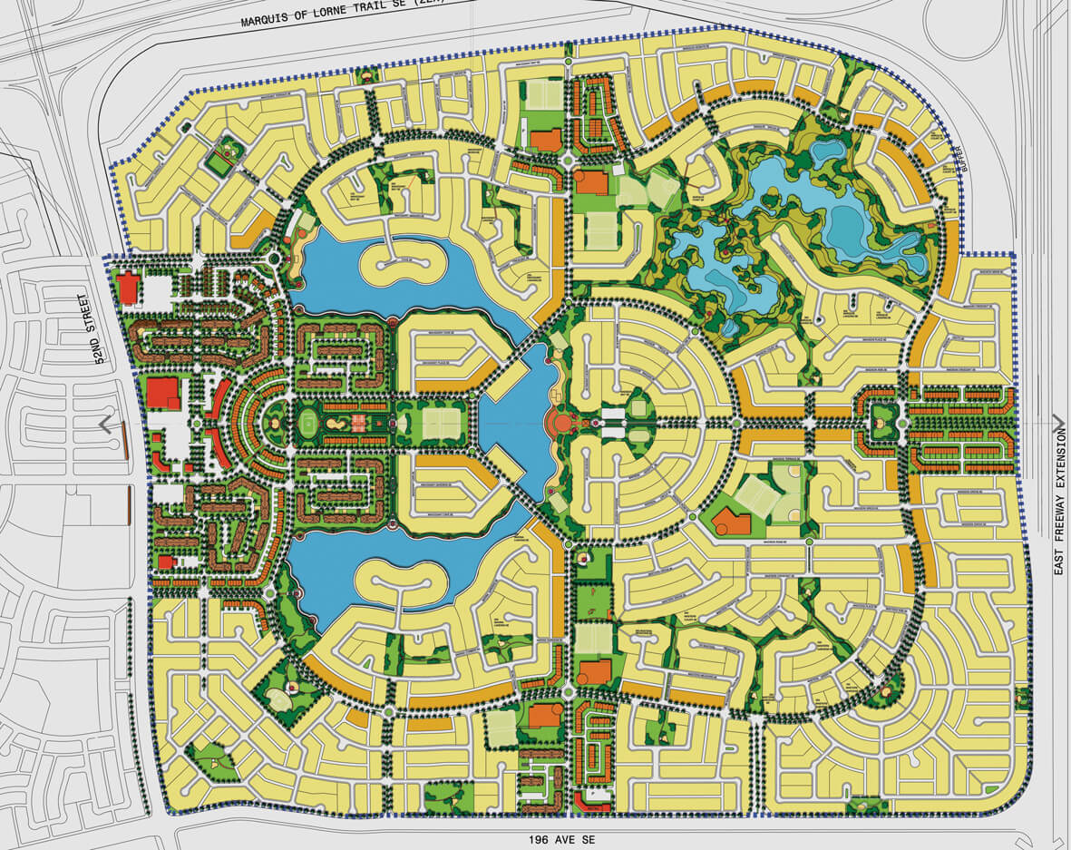
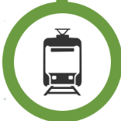
Mahogany – 1,300-acre Residential Community
Key Features:
3-PART FRESHWATER LAKE
70-ACRE NATURAL WETLAND COMPLEX
TRANSIT-ORIENTED DEVELOPMENT
OPEN SPACE SYSTEM & SCHOOLS
A RANGE OF HOUSING TYPES
4
2
1
PROJECT EXAMPLE 1
1
2
3
3
1
4
1
4

Slide 6
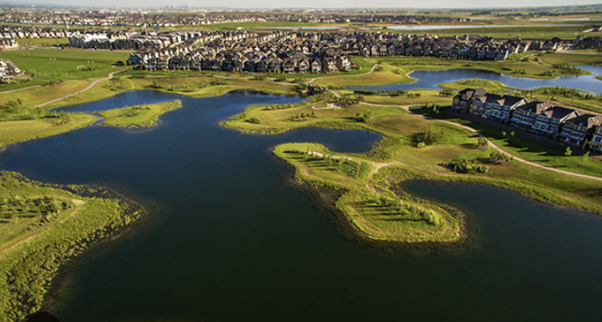
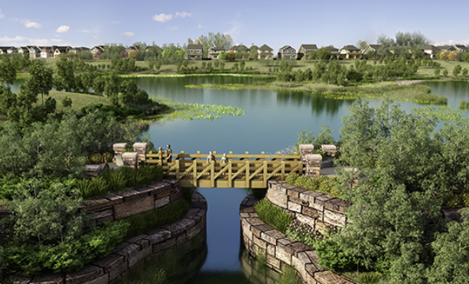
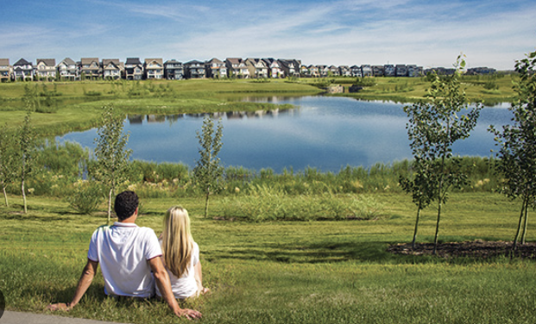
70-Acre Wetland Complex
SUSTAINABLE FEATURES

Slide 7
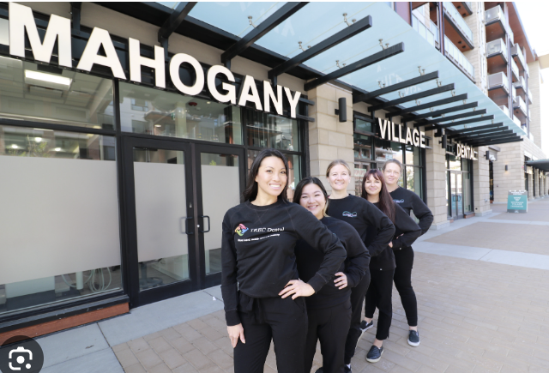
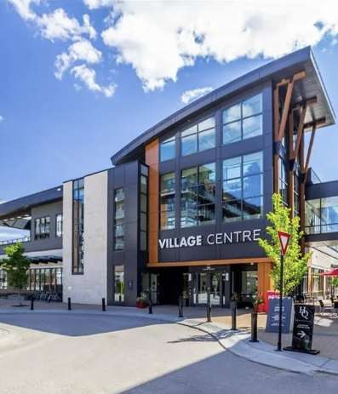
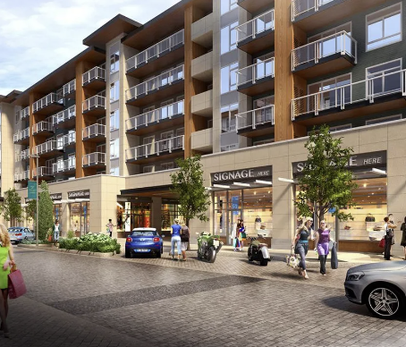
Transit Oriented Development
SUSTAINABLE FEATURES
Future
LRT Station

Slide 8
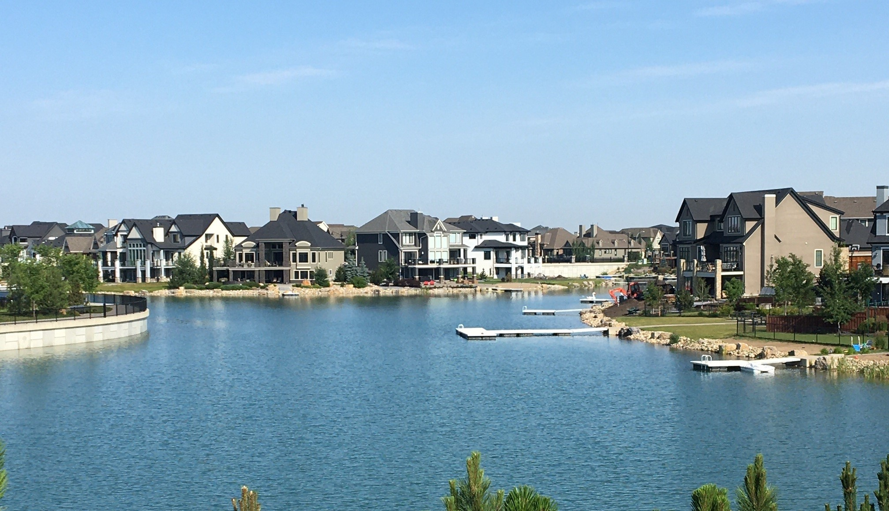
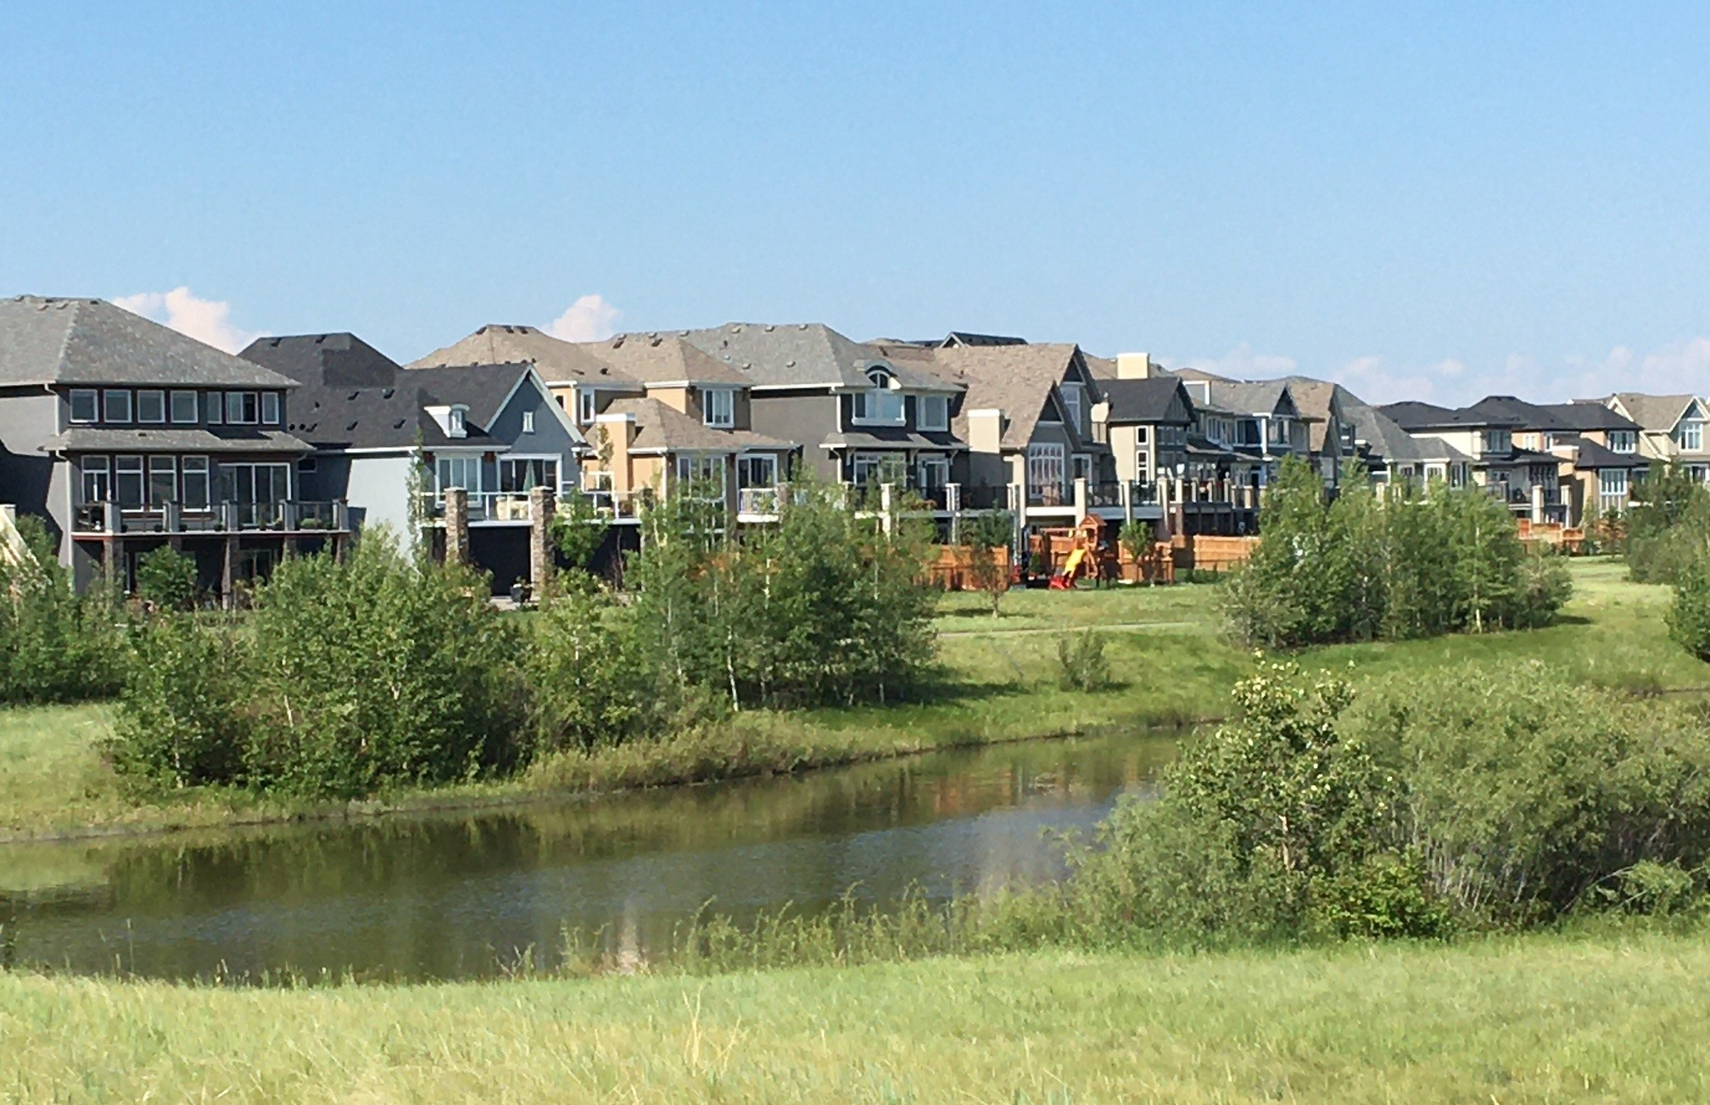
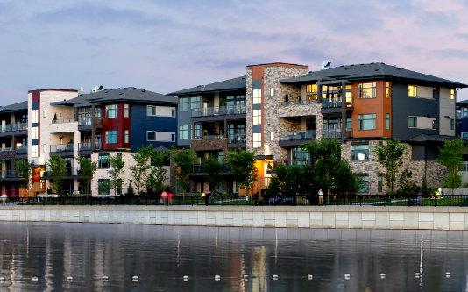
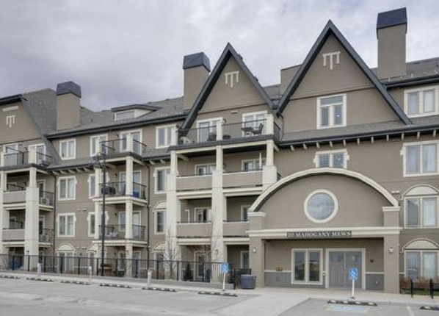
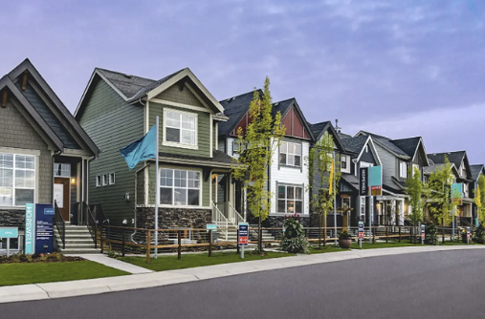
Range of Housing Types
SUSTAINABLE FEATURES

Slide 9
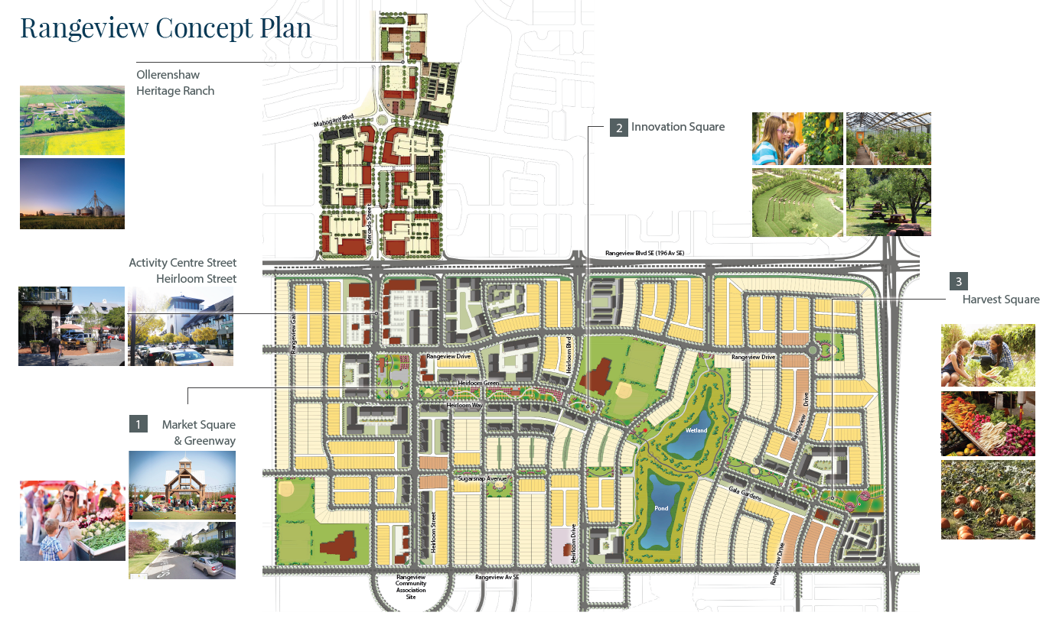
Rangeview – 320-acre Agricultural Urbanism Community
PROJECT EXAMPLE 2

Slide 10
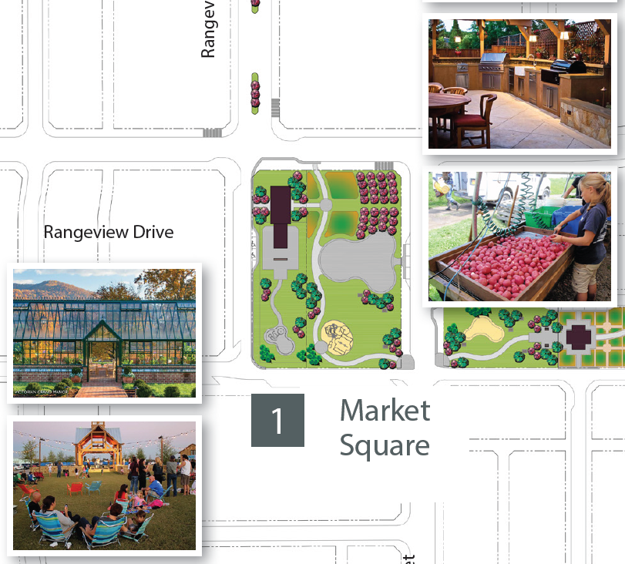
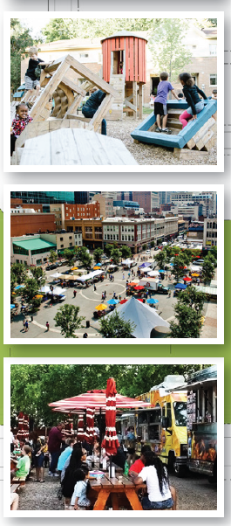
Rangeview – Market Square
SUSTAINABLE FEATURES

Slide 11
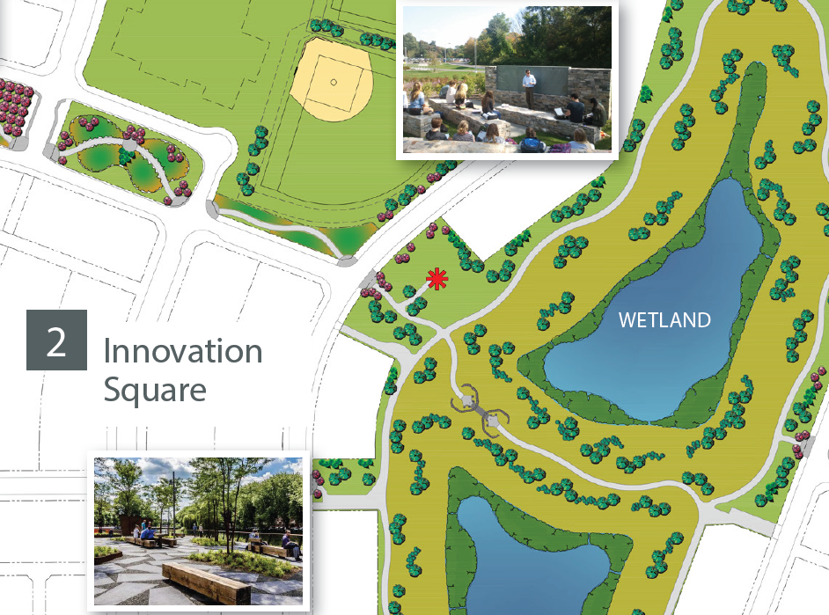
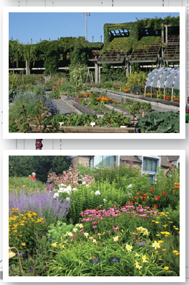
Rangeview – Innovation Square
SUSTAINABLE FEATURES

Slide 12
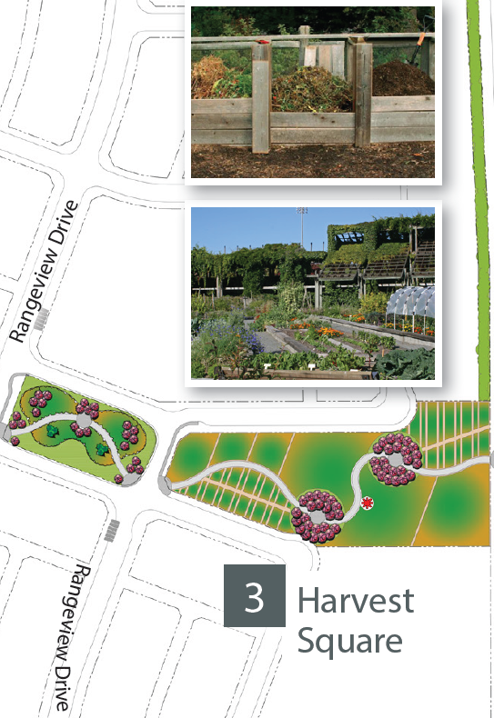
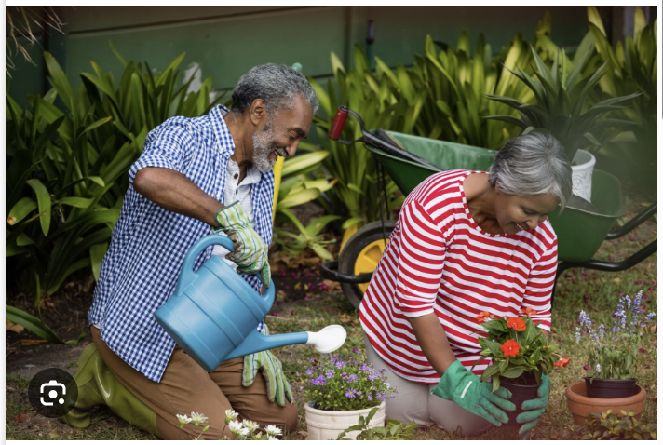
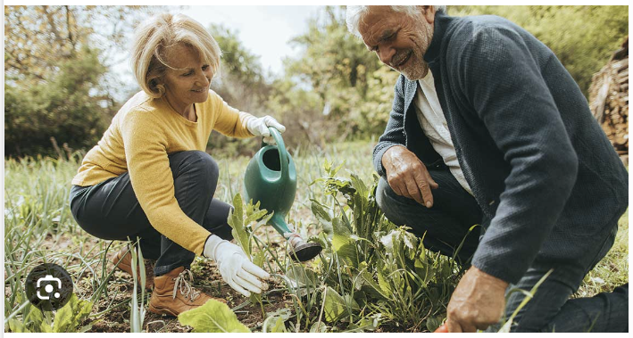
Rangeview – Harvest Square
SUSTAINABLE FEATURES

Slide 13
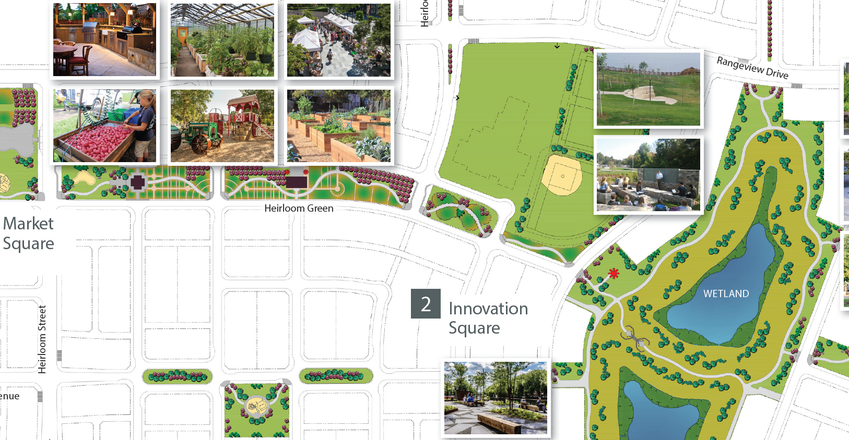
Rangeview – Greenway
SUSTAINABLE FEATURES

Slide 14
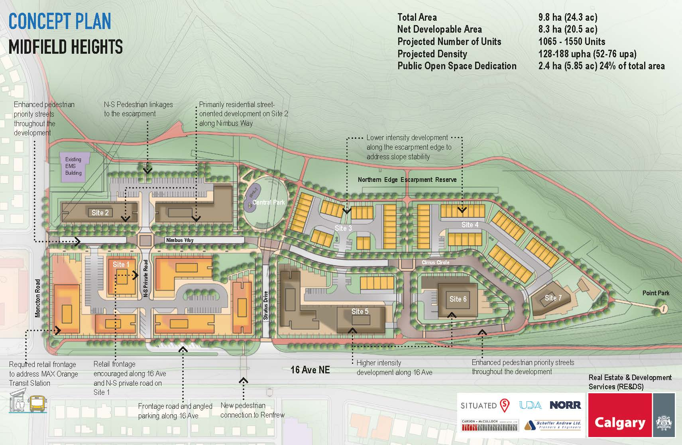
Midfield Heights – 23.5-acre Transit Oriented Development
PROJECT EXAMPLE 3

Slide 15
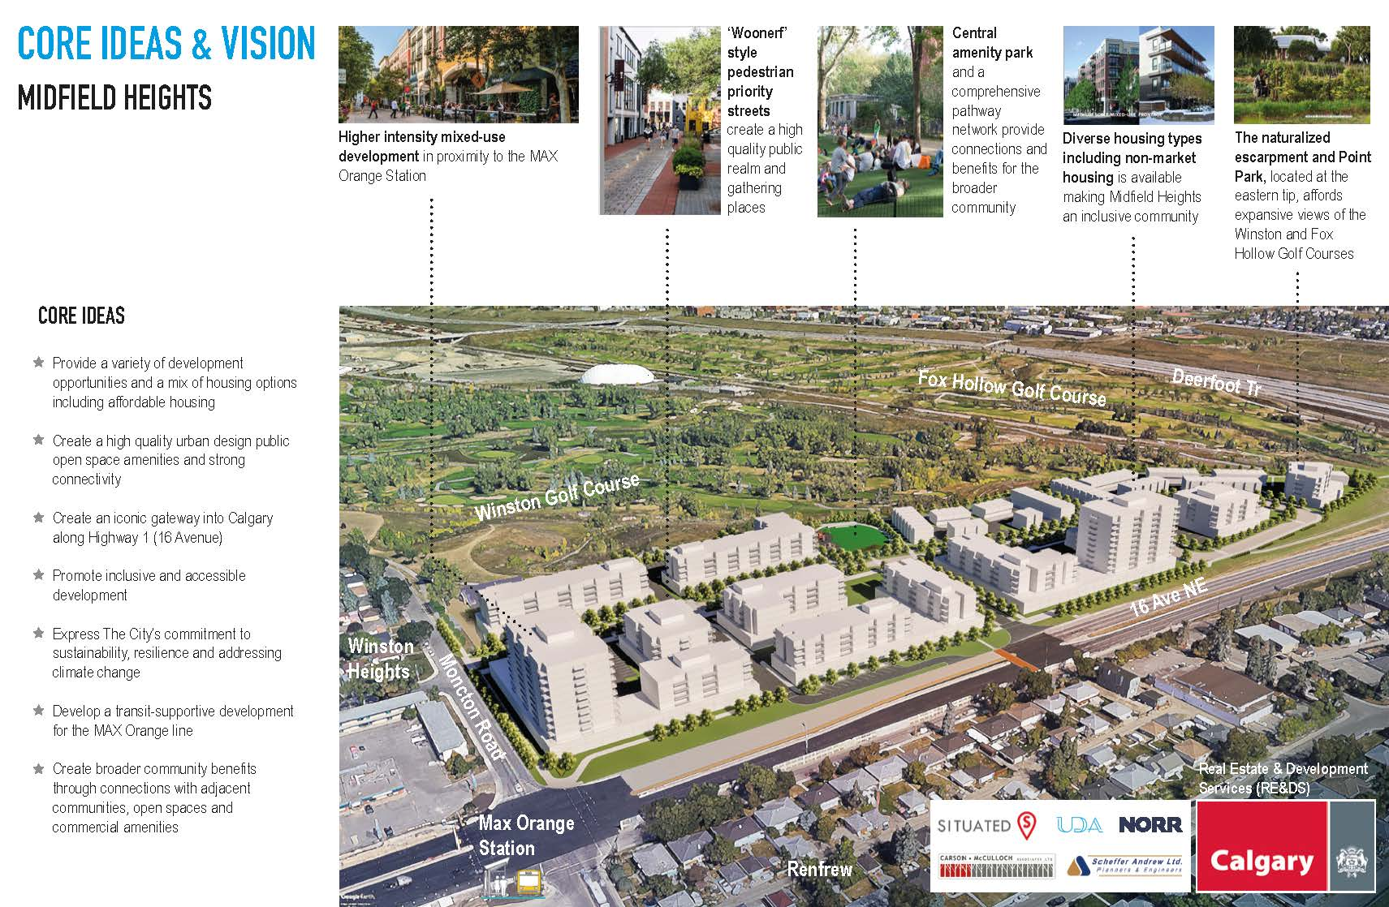
Midfield Heights – 23.5-acre Transit Oriented Development
PROJECT EXAMPLE 3

Slide 16
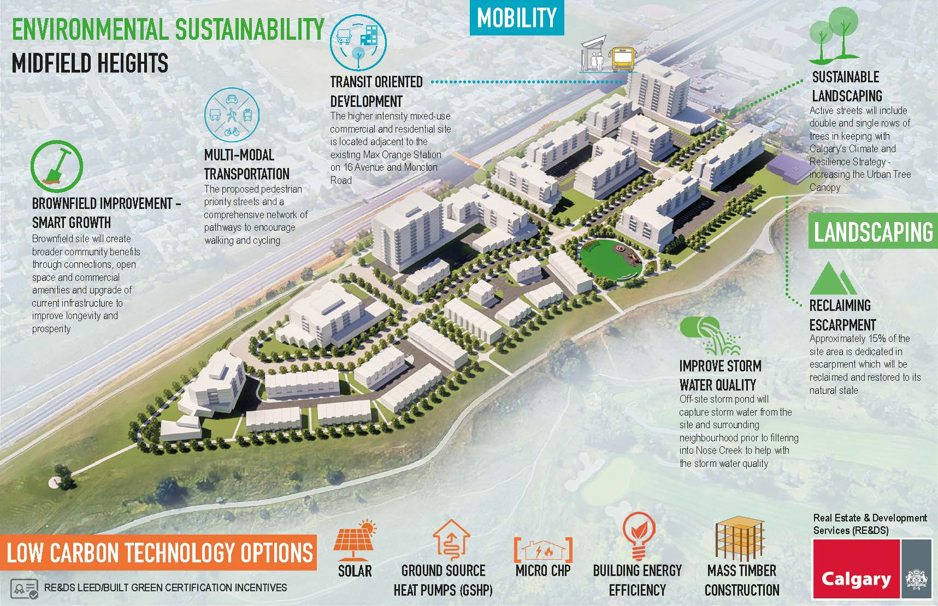
Midfield Heights – Environmental Sustainability
SUSTAINABLE FEATURES

Slide 17
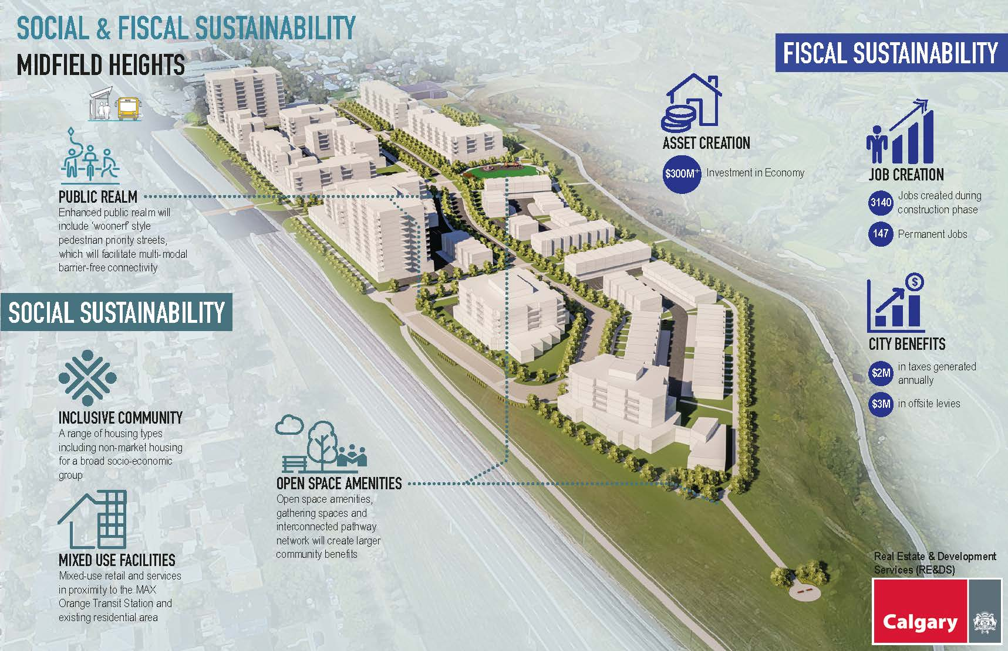
Midfield Heights – Social & Fiscal Sustainability
SUSTAINABLE FEATURES

Slide 18

Thank You
TRIPLE BOTTOM LINE SERIES
END OF PART 4:
PROJECT EXAMPLES
Part 1
Sustainability Overview
Part 2
Environmental Sustainability
Part 3
Social & Economic Sustainability

