Slide 1
TIPS ON CAR RAMPS, PARKING ETC.

Slide 2
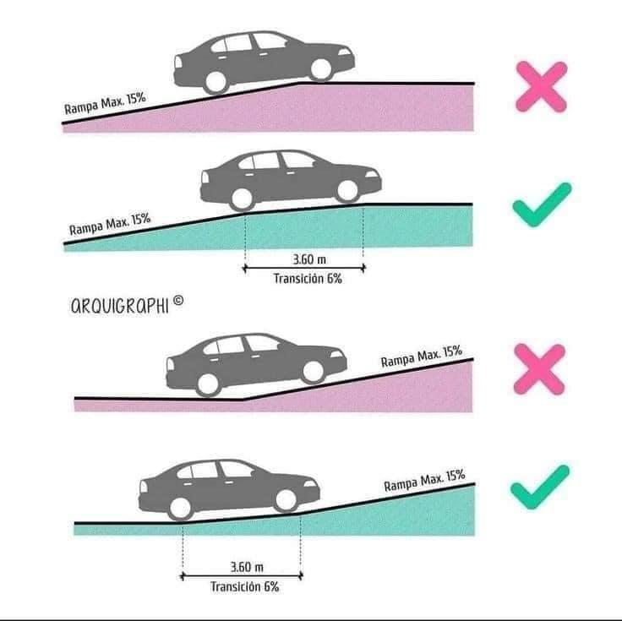
RAMP GRADIENT

Slide 3
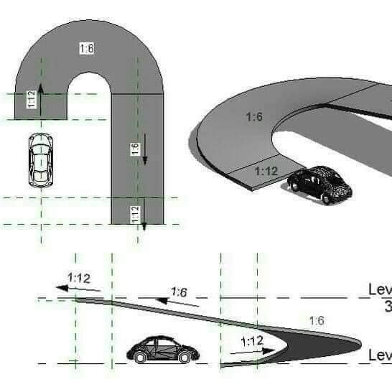
TIPS ON GRADIENT

Slide 4
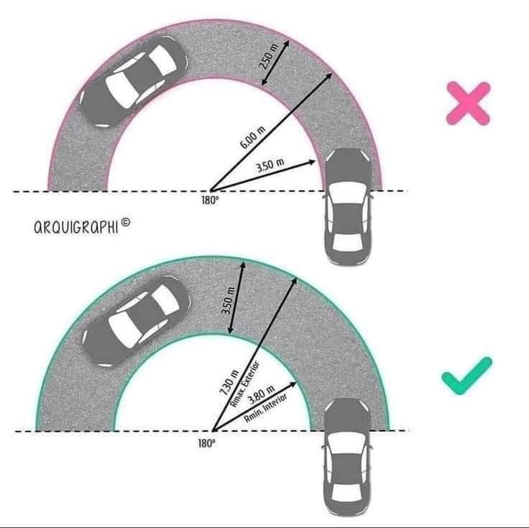
PARKING TIPS

Slide 5
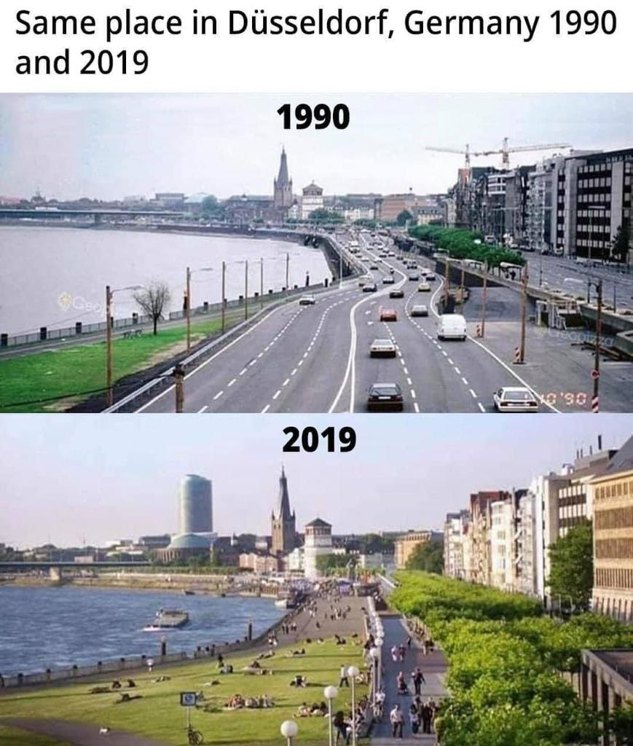
CHANGE IS POSSIBLE

